Slide 1
Domain of Protection
Presented by:Samruddhi M P

Slide 2
INTRODUCTION:
A computer system is a collection of processes and objects. By objects, we mean both hardware objects (such as the CPU, printer) and software objects(such as files, programs).
Each object has a unique name that differentiates it from all other objects in the system, and each can be accessed only through well-defined and meaningful operations.

Slide 3
Need-to-Know Principle
A process should be allowed to access only those resources for which it has authorization.
a process should be able to access only those resources that it currently requires to complete its task.
the need-to-know principle, is useful in limiting the amount of damage a faulty process can cause in the system

Slide 4
Domain Structure
process operates within a Protection Domain that specifies the resources that the process may access.
Each domain defines a set of objects and the types of operations that may be invoked on each object.
A process should be allowed to access only those resources for which it has authorization Furthermore, at any time, a process should be able to access only those resources that it currently requires to complete its task.
The ability to execute an operation on an object is an access right.

Slide 5
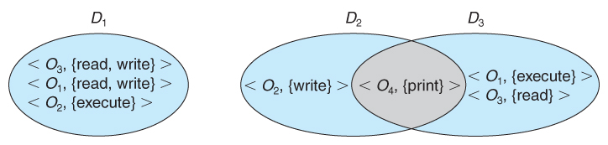
System with three Protection domains
For example, if domain D has the access right <file F, {read, write}>, then a process executing in domain D can both read and write file F; it cannot, however, perform any other operation on that object.

Slide 6
System with three protection domains
A domain can be realized in a variety of ways: Each user may be a domain. In this case, the set of objects that can be accessed depends on the identity of the user.
Each process may be a domain. In this case, the set of objects that can be accessed depends on the identity of the process

Slide 7
The association between protection and domain
Static association
If the set of resources available to the process is fixed throughout the process's lifetime
Dynamic Association.
Establishing dynamic protection domains is more complicated than establishing static protection domains

Slide 8
Example of UNIX:
In the UNIX operating system, a domain is associated with the user.
In Unix operating system user ID's use for identify the domain.

Slide 9
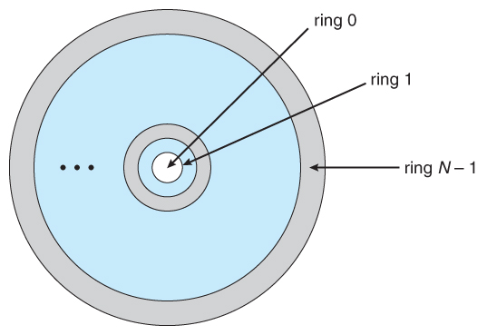
Example of MULTICS:
In the MULTICS system, the protection domains are organized into a ring structure. Each ring corresponds to a single domain.

Slide 10
Conlusion:
In conclusion, domains of protection are essential in modern operating systems to ensure the security and reliability of computer systems.

Slide 11
Thank you…

